Slide 1
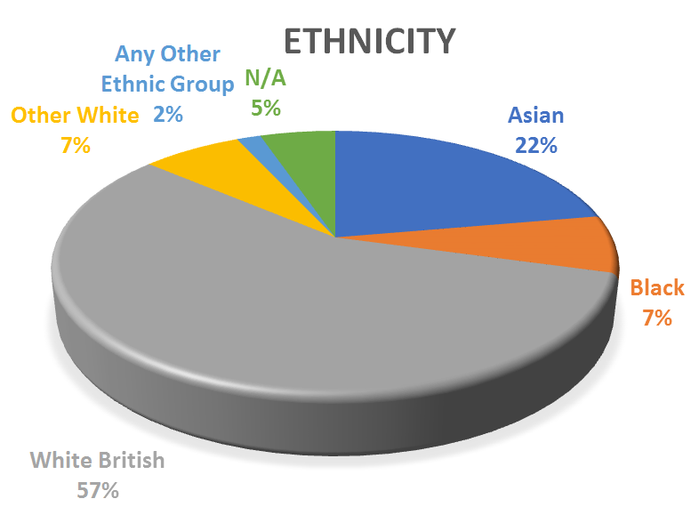
Which admission parameters are associated with poor COVID-19 outcome? A real world study.
Parisa Khonsari, Parhana Polly, Parushak Rezai, Muhammad K Nisar
Luton and Dunstable University Hospital
Introduction
Coronavirus disease 2019 (COVID-19) has claimed over 5.8 million lives worldwide, and created a significant burden on healthcare globally (1,2).
Efforts have been made to prognosticate patients to help prioritise clinical care. Both hypokalaemia and hyponatremia at presentation have been associated with severe COVID-19 (3). However it remains unclear whether electrolyte derangement at first contact can identify critical care admission and mortality risk.
Objectives
The aim of our study is to:
investigate the initial electrolyte abnormalities present on admission to hospital with COVID-19 before any treatments are initiated; and
determine whether these could be indicators of outcomes such as critical care admission and mortality.
Methods
Retrospective survey of 481 consecutive adult patients with confirmed COVID-19 admitted to university teaching hospital from January 2020 to April 2020.
Data collection was done through electronic health records. Fisher’s exact and Student T tests were employed to ascertain significant relationship among mortality and critical care admissions measured against initial electrolyte result.
Results and Discussion
A total of 481 patients were admitted.
197 (41%) female and 284 (59%) male
217 (45%) died due to COVID-19
60 (12%) of patients were admitted to critical care
Mean length of hospital admission: 11 days (range 1-69)
Mean length of critical care admission: 11 days (range 1-54)
Those who were not admitted to critical care included patients who did not require critical care input during their admission, or were not clinically suitable for ventilation.
Derangement in chloride (P=0.0376), glucose (P= 0.0305), and potassium (P= 0.0235) on admission were significantly associated with increased mortality.
23% (111) of patients had acute kidney injury (AKI) on admission, which was significantly associated with mortality (p= 0.0003).
No statistically significant relationship was identified for critical care admission.
A prior systematic review concluded that serum potassium derangement was associated with unfavourable outcomes including death (4). Our study adds glucose and chloride levels and AKI to the prognostic marker list. This is a major strength of our study and provides clinicians with an effective and readily available tool to focus their efforts on these patients. Such prognostic strategy can be highly effective and a safe way to address thinly stretched healthcare resources for people admitted with COVID-19.
 | All patients n=481 | Alive n=264 | Dead n=217 | Admitted to critical care n=60 | Not admitted to critical care n=421
Mean Age (range) | 68 (18-98) | 62 (18-97) | 75 (28-98) | 57 (23-76) | 70 (78-98)
Table 2. Mean ages of patients
 |  | Alive | Dead | Critical Care Admission | No Critical Care Admission | Total no. of patients
Chloride n=445 | Normal | 199 | 151 | 48 | 302 | 350
 | Abnormal | 39 | 56 | 12 | 83 | 95
Glucose n=444 | Normal | 208 | 155 | 45 | 318 | 363
 | Abnormal | 30 | 51 | 15 | 66 | 81
Lactate n=443 | Normal | 206 | 178 | 50 | 334 | 384
 | Abnormal | 32 | 27 | 9 | 50 | 59
Bicarbonate n=371 | Normal | 166 | 116 | 45 | 237 | 282
 | Abnormal | 33 | 56 | 9 | 80 | 89
Phosphate n=383 | Normal | 143 | 107 | 39 | 211 | 250
 | Abnormal | 64 | 69 | 21 | 112 | 133
Magnesium n=389 | Normal | 169 | 123 | 38 | 254 | 292
 | Abnormal | 40 | 57 | 22 | 75 | 97
Sodium n=479 | Normal | 211 | 161 | 50 | 322 | 372
 | Abnormal | 51 | 56 | 10 | 97 | 107
Potassium n=476 | Normal | 234 | 180 | 54 | 360 | 414
 | Abnormal | 26 | 36 | 6 | 56 | 62
AKI n=478 | No | 218 | 149 | 43 | 324 | 367
 | Yes | 44 | 67 | 17 | 94 | 111
Figure 1. Ethnicities of patients admitted with COVID-19.
Table 1.All parameters studied, categorised into normal or abnormal reading on admission, with outcomes measured: mortality and critical care admission.

